Slide 1
Why leaders need to build businesses that ‘fail safely’
Organisational psychologist and H&S expert
Dr Todd Conklin talks to Forum leaders
May 2017

Slide 2
How to use this power-point
We’ve turned Dr Conklin’s talk into a workshop tool. Use it to support conversations with your people & directors.
Watch one chapter, pause and discuss the questions, then move to the next chapter.
Thanks to Dennis Barnes, CEO Contact Energy, for supporting Dr Conklin’s visit to NZ.

Slide 3
We need to change our definition of safety
Chapter 1
‘Safety is not the absence of accidents. Safety is the presence of defences.’ - Dr Todd Conklin

Slide 4
Chapter 1 - Background
Volvo has a goal of creating a fatality-free car by 2020.
But since 2007, there have been no recorded deaths in car-wrecks involving Volvos.
So, does Volvo already make a fatality free car? And if so, how did it achieve that impressive goal?

Slide 5
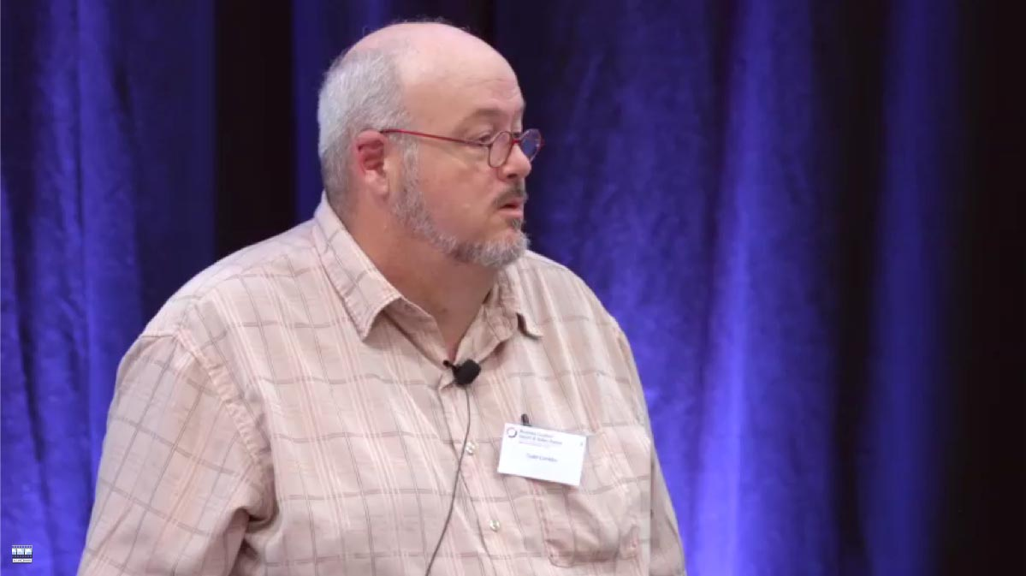
Watch the YouTube video for Chapter 1
https://youtu.be/L2Dp5HIk2Ss

Slide 6
How well do we manage our organisation’s ability to fail safely?
Chapter 1 - Pause and discuss:

Slide 7
We need safe systems, not just safe workers
Chapter 2
‘If you need 100% accuracy get a machine. It’s not possible from humans.’ - Dr Todd Conklin

Slide 8
Chapter 2 - Background
Before watching this chapter, view this short video at www.youtube.com/watch?v=G63Op086LXo
It shows ‘Kenny the alligator wrestler’ performing a stunt he’s done safely many, many times before. Until one day he makes a mistake …
Note, this video is not graphic. But it does include images of Kenny being bitten by the alligator.

Slide 9
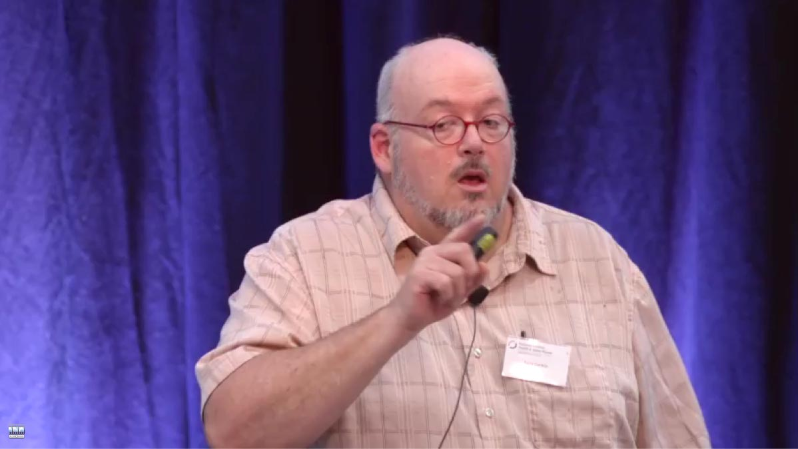
Watch the YouTube video for Chapter 2
https://youtu.be/lWPJzGtmiOQ

Slide 10
How many operators do we have whose only defence against injury is that they’ll do the job right every time?
Chapter 2 - Pause and discuss:

Slide 11
How to be safe
Chapter 3
’You want to be a company that fails often, softly & effectively. Cause that’s how you become the safest company in the world.’ – Dr Todd Conklin

Slide 12
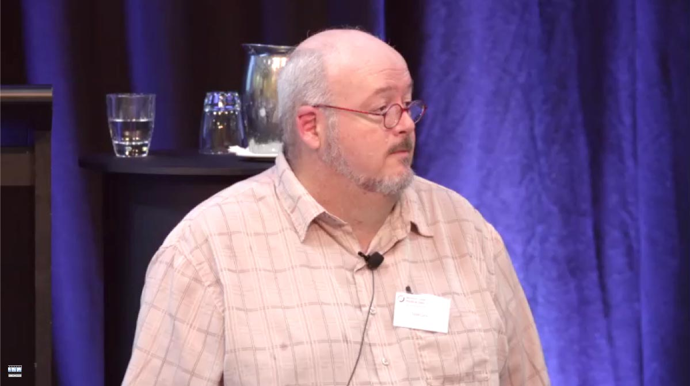
Watch the YouTube video for Chapter 3
https://youtu.be/qFDLmZXBaMs

Slide 13
In our facility, what can kill people? When it happens, what stops people dying? Is that enough?
Chapter 3 - Pause and discuss:

Slide 14
Final thoughts
‘When an incident happens, start your investigation by looking at the system.
Then if you need to, look at the worker.
But I promise you, when you look at the system your need to look at the worker almost always goes away.’ – Dr Todd Conklin

Slide 15
Want to know more?
For more ideas on managing risk & investing in H&S, view our CEO Safety Leadership model & Monitoring What Matters guide.
Or read more from Dr Conklin at: http://www.amazon.com/Todd-Conklin/e/B00TATZUOI
If you’d like to continue this conversation with other Forum CEOs drop the Forum a line at info@zeroharm.org.nz.

